Slide 1
Nucleation and control in the solidification process of Al-Bi monotectic alloy
Name:Zhang Youkang
Major:Material forming and control engineering
Graduate University:Qilu University of Technology

Slide 2
01
Introduction of the monotectic alloy
CONTENTS
02
Experiment Content
03
Analysis and Conclusion

Slide 3
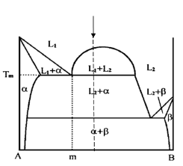
01
Introduction of the monotectic alloy
Characterized by a liquid miscibility gap
Al-Pb monotetic alloy is an engine bearing material
Zn-bi alloys have excellent electrochemical properties
It is difficult to prepare homogeneous alloy due to the existence of liquid phase separation

Slide 4
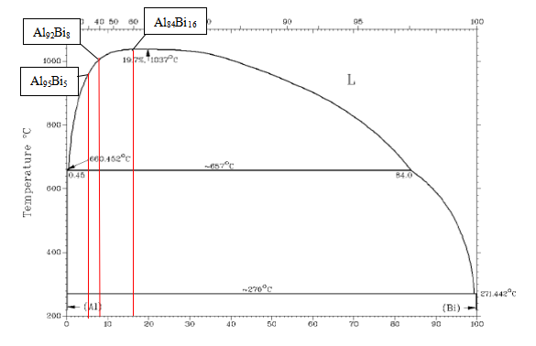
02
Experiment Content
Experiment object：Al-Bi montectic alloy
Process：Choose three different compositions Al-Bi
alloy
Add different ratios of Al-5Ti-1B grain refiners
0%、0.1%、0.2%、0.5%
Add the microalloying element Sn, Cu and Si
Analysis：The effect of adding Al-5Ti-1B and microalloying
elements on the solidification of Al-Bi alloy was
investigated by solidification curve and microstructure
observation

Slide 5
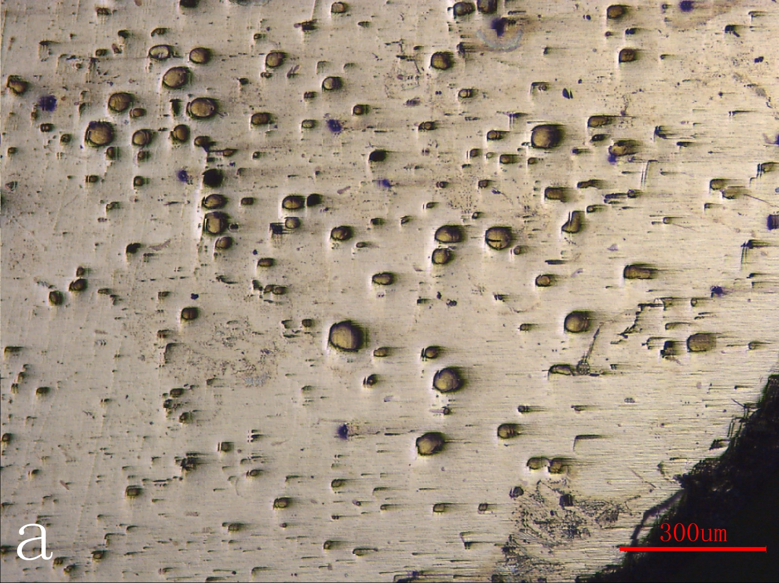
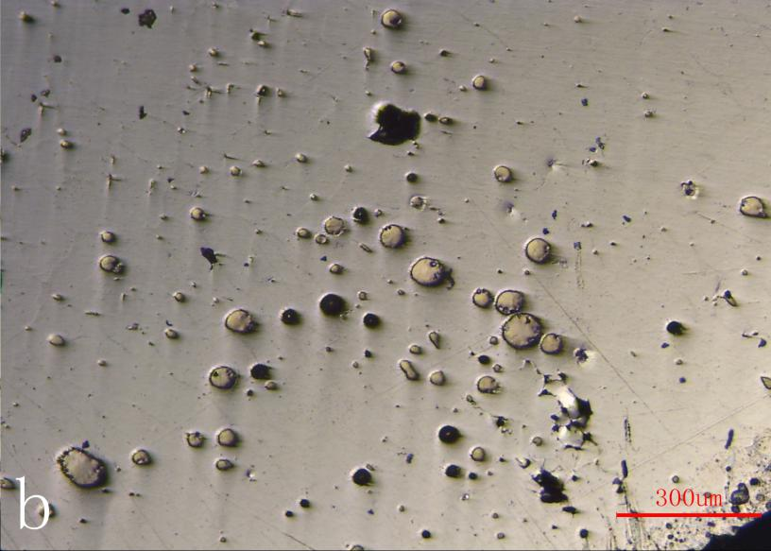
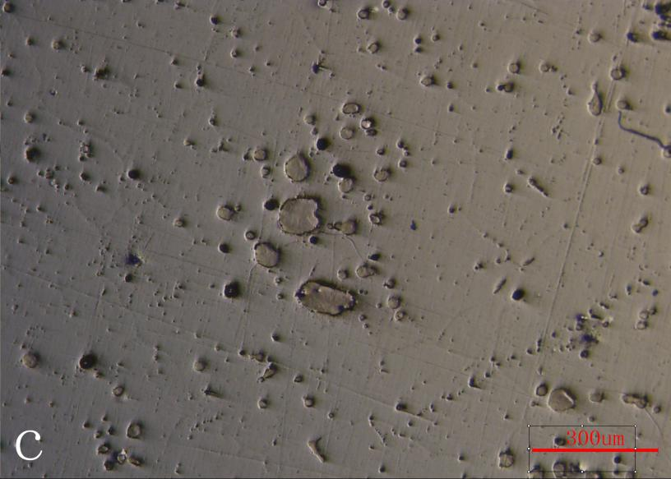
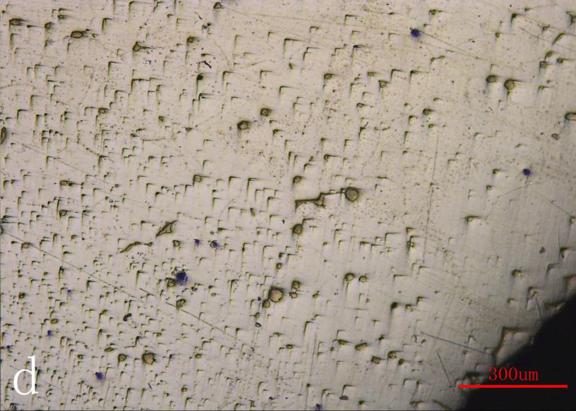
03
Analysis and Conclusion
The influence of Al-5Ti-1B addition on solidification nucleation of Al-Bi alloy
The solidification curve of Al₉₅Bi₅ adds a different ratio of Al-5Ti-1B（a）The whole solidification（b）The process of monotectic reaction
Metallographic photographs of Al-Bi alloy with different ratio of Al-5Ti-1B（a）0%Al-5Ti-1B（b）0.1%Al-5Ti-1B（c）0.2%Al-5Ti-1B（d）0.5%Al-5Ti-1B

Slide 6
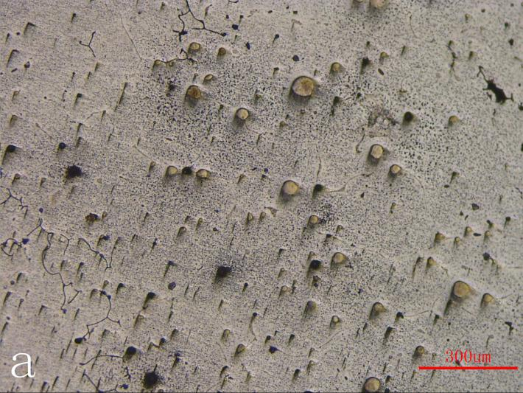
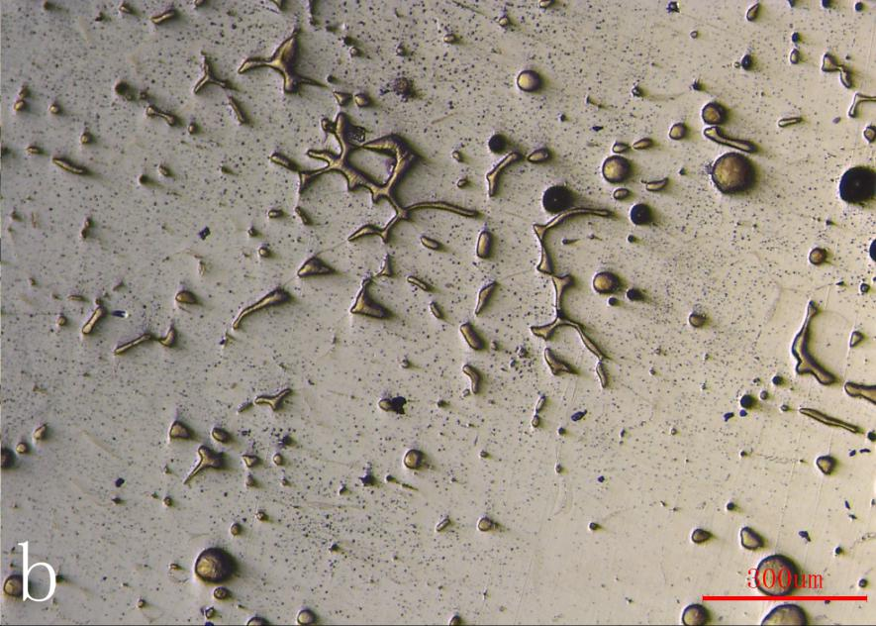
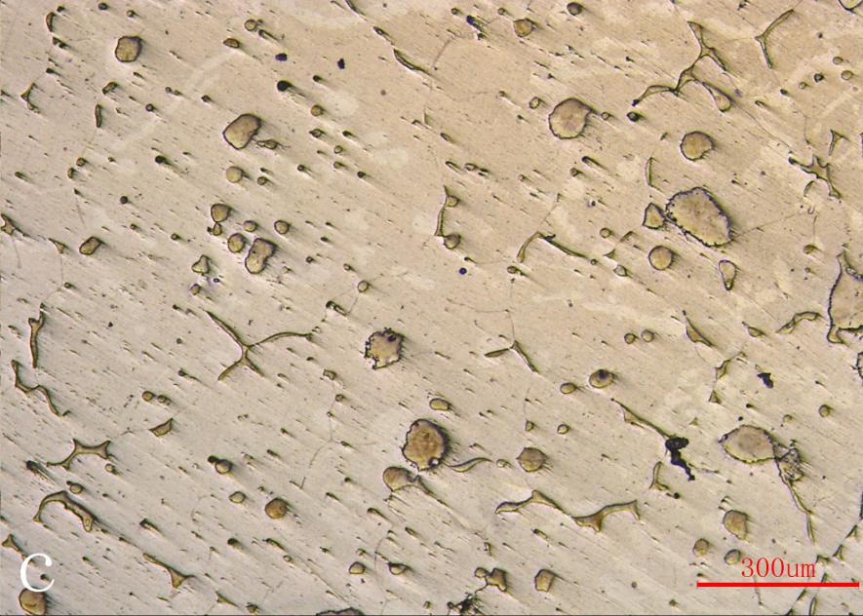
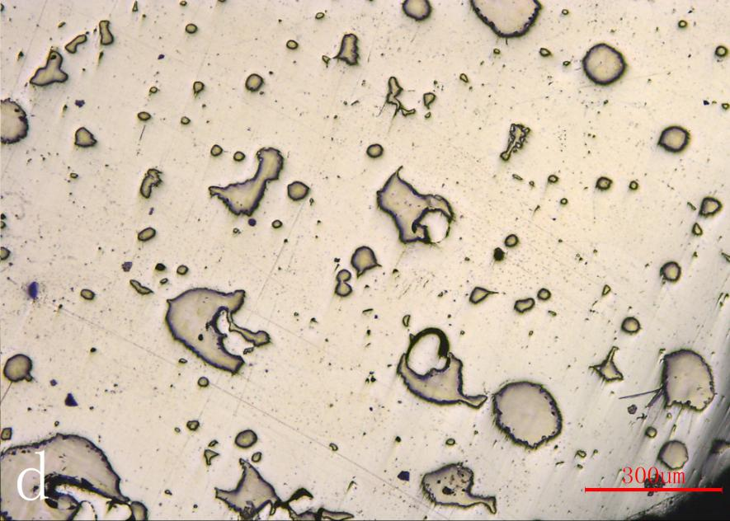
03
Analysis and Conclusion
The solidification curve of Al₉₂Bi8 adds a different ratio of Al-5Ti-1B（a）The whole solidification（b）The process of monotectic reaction
Metallographic photographs of Al-Bi alloy with different ratio of Al-5Ti-1B（a）0%Al-5Ti-1B（b）0.1%Al-5Ti-1B（c）0.2%Al-5Ti-1B（d）0.5%Al-5Ti-1B

Slide 7
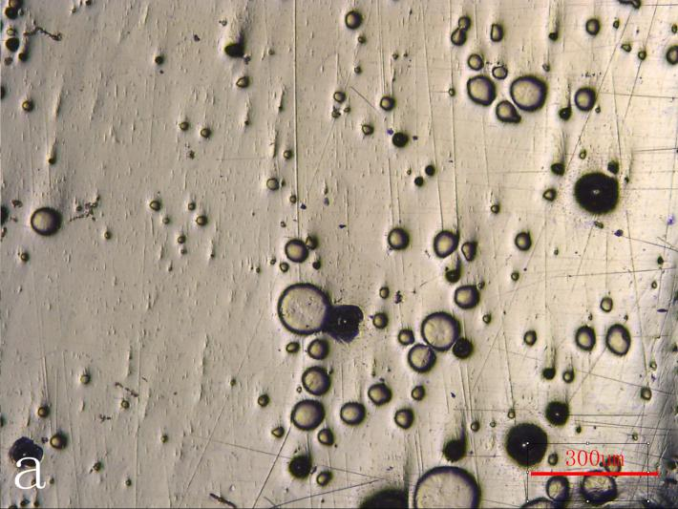
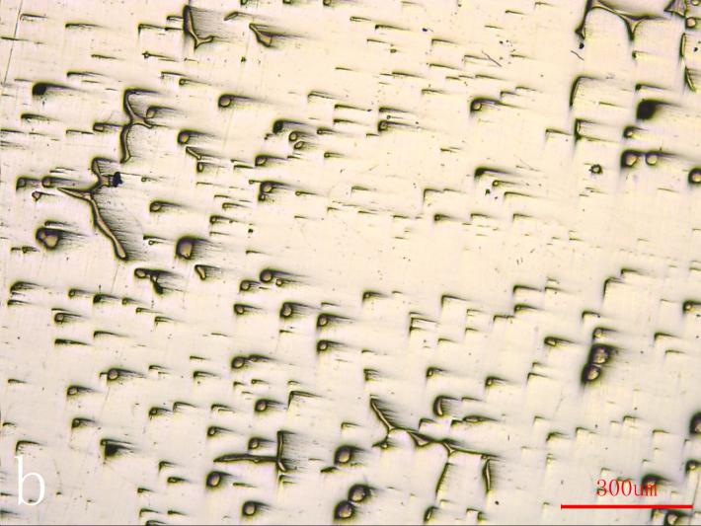
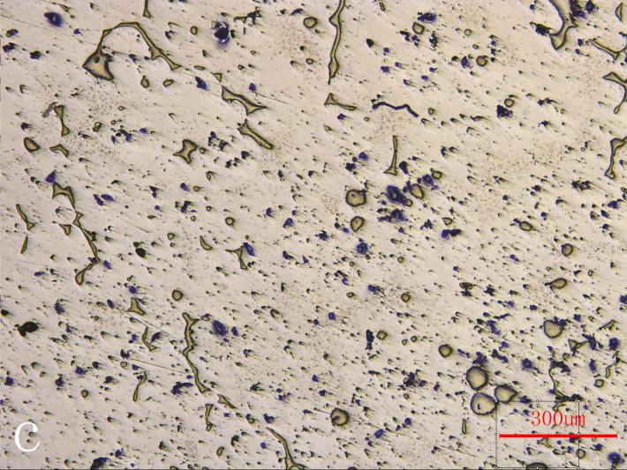
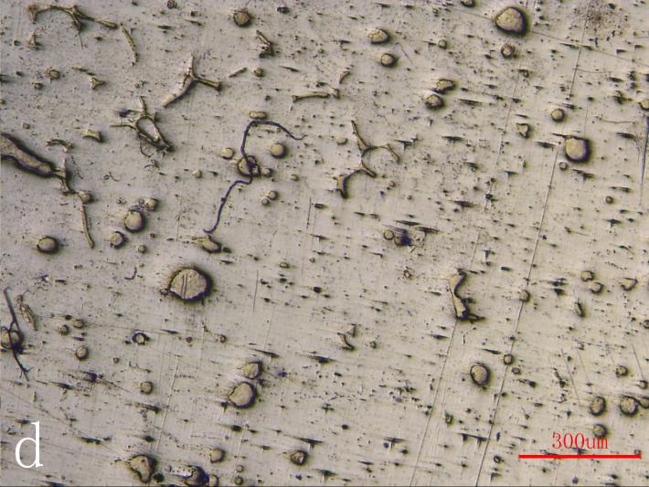
03
Analysis and Conclusion
The solidification curve of Al₈₄Bi₁₆ adds a different ratio of Al-5Ti-1B（a）The whole solidification（b）The process of monotectic reaction
Metallographic photographs of Al-Bi alloy with different ratio of Al-5Ti-1B（a）0%Al-5Ti-1B（b）0.1%Al-5Ti-1B（c）0.2%Al-5Ti-1B（d）0.5%Al-5Ti-1B

Slide 8
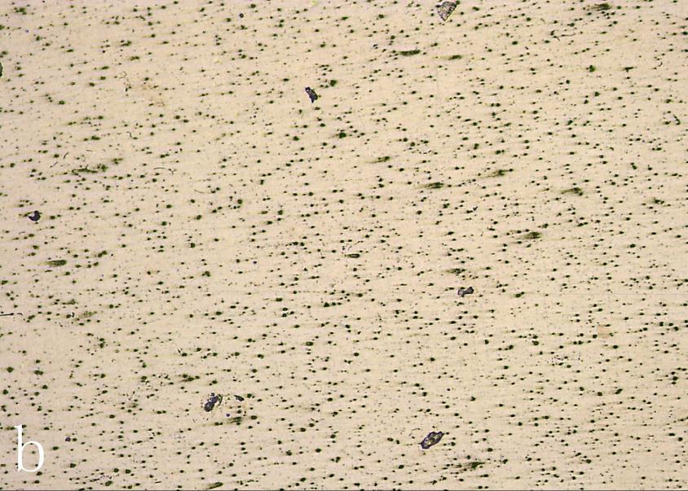
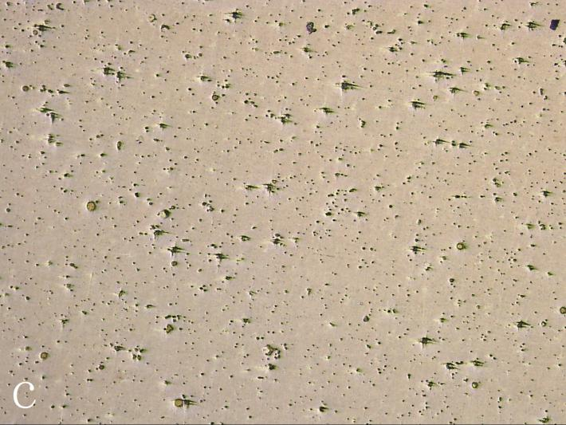
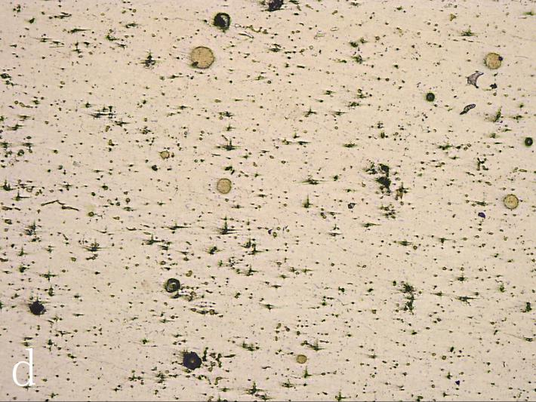
03
Analysis and Conclusion
The influence of microalloying elements Sn, Cu and Si addition on the solidification process of Al₉₂Bi₈ alloy
The solidification curves of (Al_{0.92}Bi_{0.08})₉₉Sn₁、(Al_{0.92}Bi_{0.08})₉₉Cu₁、(Al_{0.92}Bi_{0.08})₉₉Si₁ （a）The whole solidification（b）The process of monotectic reaction
The metallographic photographs: (b)、(Al_{0.92}Bi_{0.08})₉₉Sn₁、(c)、(Al_{0.92}Bi_{0.08})₉₉Cu₁、(d)、(Al_{0.92}Bi_{0.08})₉₉Si₁

Slide 9
03
Analysis and Conclusion
The addition of Al-5Ti-1B makes Al-Bi alloy nucleation undercooling degree decreases, and the addition of Al-5Ti-1B release TiB₂ as the heterogeneous nucleation point, changing the mode of grain growth, change the form of second phase particles precipitate Bi, refine the grain size.
The addition of Sn, Cu and Si elements in Al-Bi alloy can change the size of the second phase Bi particle, Sn can reduce Bi particle size, Cu and Si increases Bi particle size.

Slide 10
Thanks！

